Slide 1

AIR BNB Hotel Booking Analysis Project
Souptik Roy
INTERNSHIP_17546440516895be537820f

Slide 2

PROBLEM STATEMENT
Airbnb is a popular platform where property owners rent out their homes or apartments to travelers. One of the biggest challenges for hosts is deciding the right price for their listings, since prices vary depending on several factors such as the number of bedrooms, number of bathrooms, cleanliness, accuracy of descriptions, and communication quality with guests.

Slide 3
Project Description
This project aims to build a machine learning model that predicts the prices of Airbnb listings. Setting the right price is essential — hosts want to attract more guests and boost their earnings, while travelers look for reasonable and competitive rates. By analyzing historical Airbnb data, the model learns how various factors like the number of bedrooms, bathrooms, location, and guest ratings influence the listing price. Once trained, it can estimate prices for new or potential listings, helping property owners make smarter, data-driven pricing decisions.

Slide 4

WHO ARE THE END USERS?
Travelers: Assess whether a stay offers good value for its price.
Researchers/Students: Analyze how listing features and reviews influence pricing.
Airbnb Hosts: Adjust property rates effectively based on data insights.
Platform Analysts: Enhance pricing algorithms and boost user confidence.

Slide 5

Technology Used
Python - Core programming language
Pandas & NumPy - Data cleaning and preprocessing
Scikit-learn- Machine learning (model training, regression, evaluation)
Matplotlib- Data visualization and feature importance
VS Code- Google Colab Cloud-based environment for running the project
File handling libraries - openpyxl (for Excel) and built-in CSV handling

Slide 6
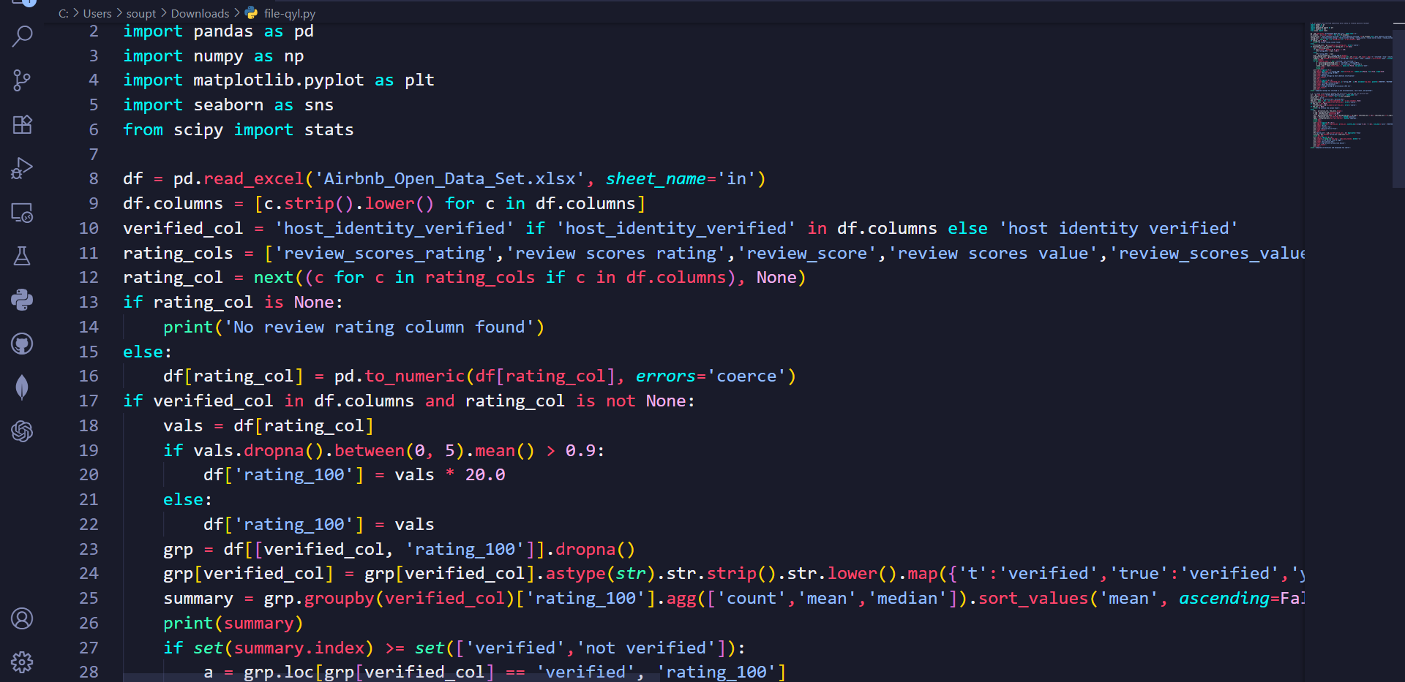
RESULTS1
Demo Link

Slide 7
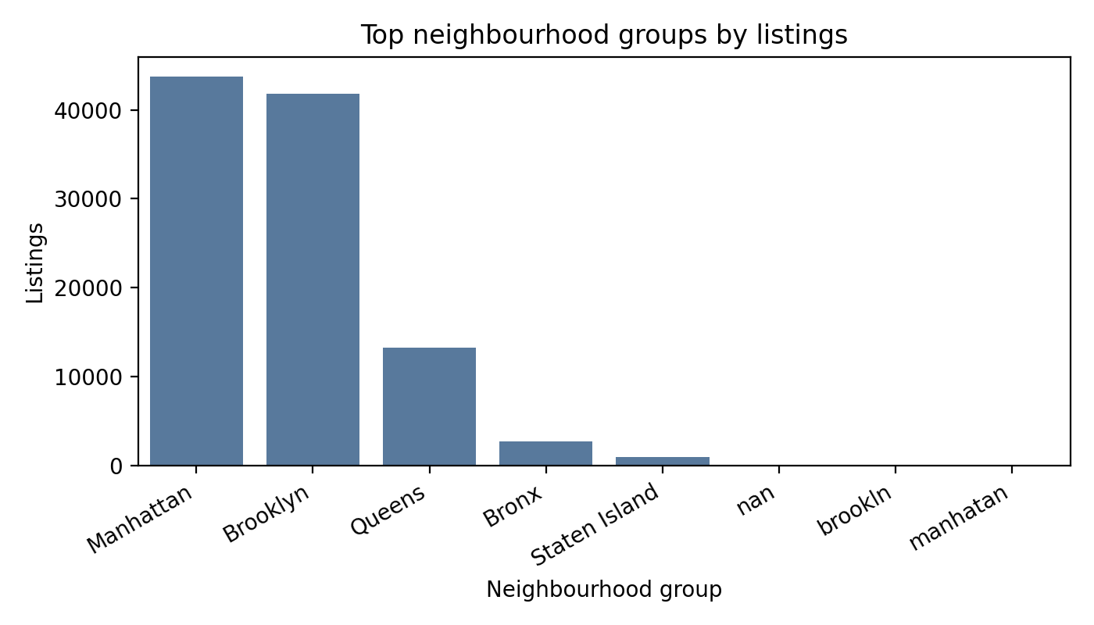
RESULTS2
Demo Link

Slide 8
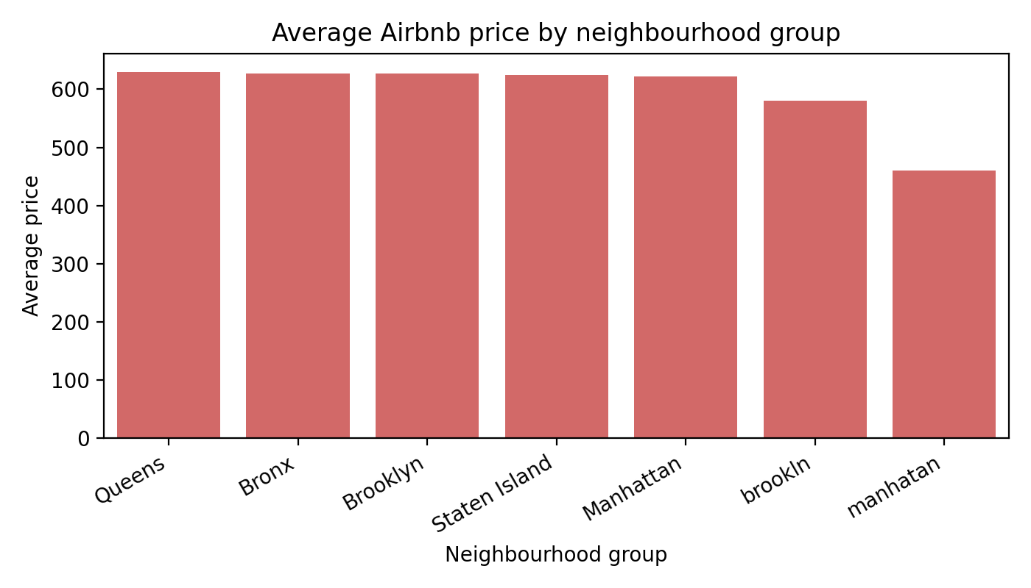
RESULTS3
Demo Link

Slide 9
GitHub repository
https://github.com/Souptik-Roy/VOIS_AICTE_Oct2025_SouptikRoy.git
Demo Link

Slide 10
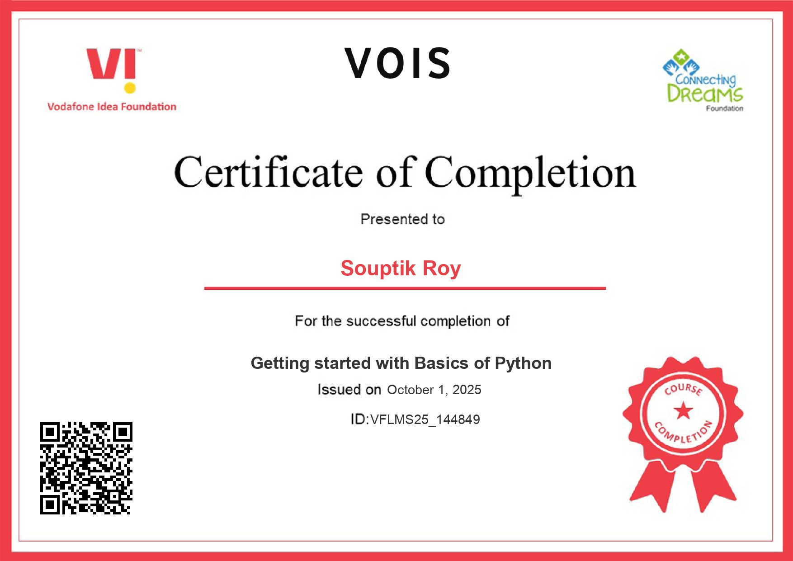
Getting started with Basics of Python Certificate

Slide 11
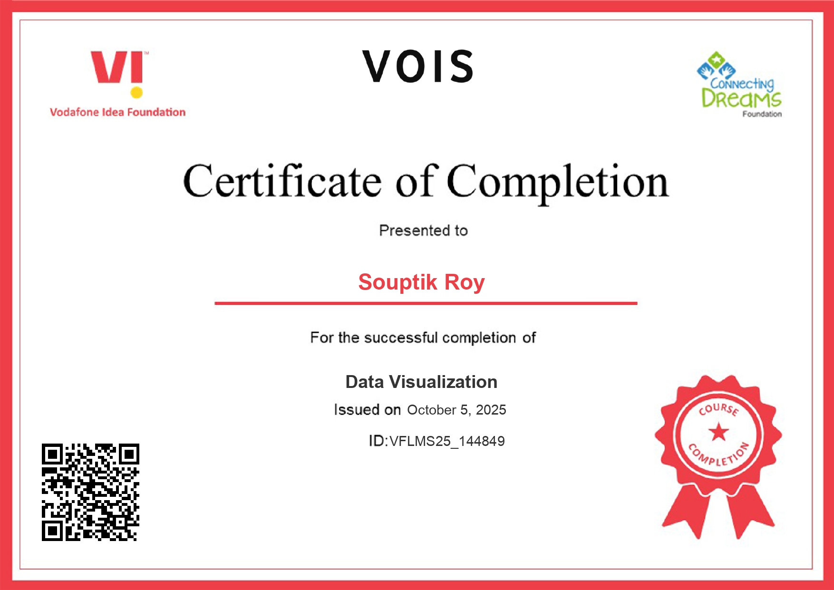
Data Visualization Certificate

Slide 12
Thank you
.
.

